Slide 1
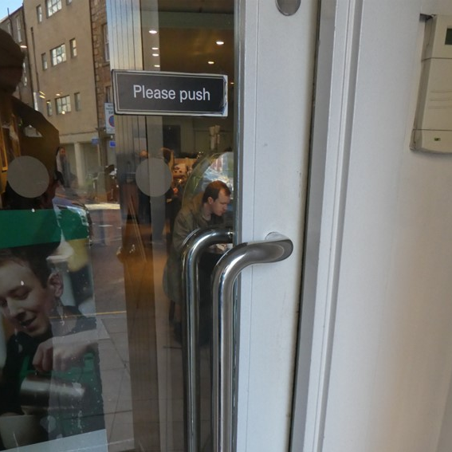
Phishing: Balancing Human and AI Capabilities
9:30 - 10:00
Dr Kami Vaniea
University of Waterloo
Electrical and Computer Engineering
Kami.Vaniea@uwaterloo.ca
https://vaniea.com

Slide 2
People make complex security decisions daily. Context strongly impacts how information is interpreted.

Slide 3
Donation point, just dip your credit card!
Safe to donate?

Slide 4
Cookie consent box on a website.
Is this website safe to browse?
Is it safe to enter personal data on?

Slide 5
Phishing

Slide 6
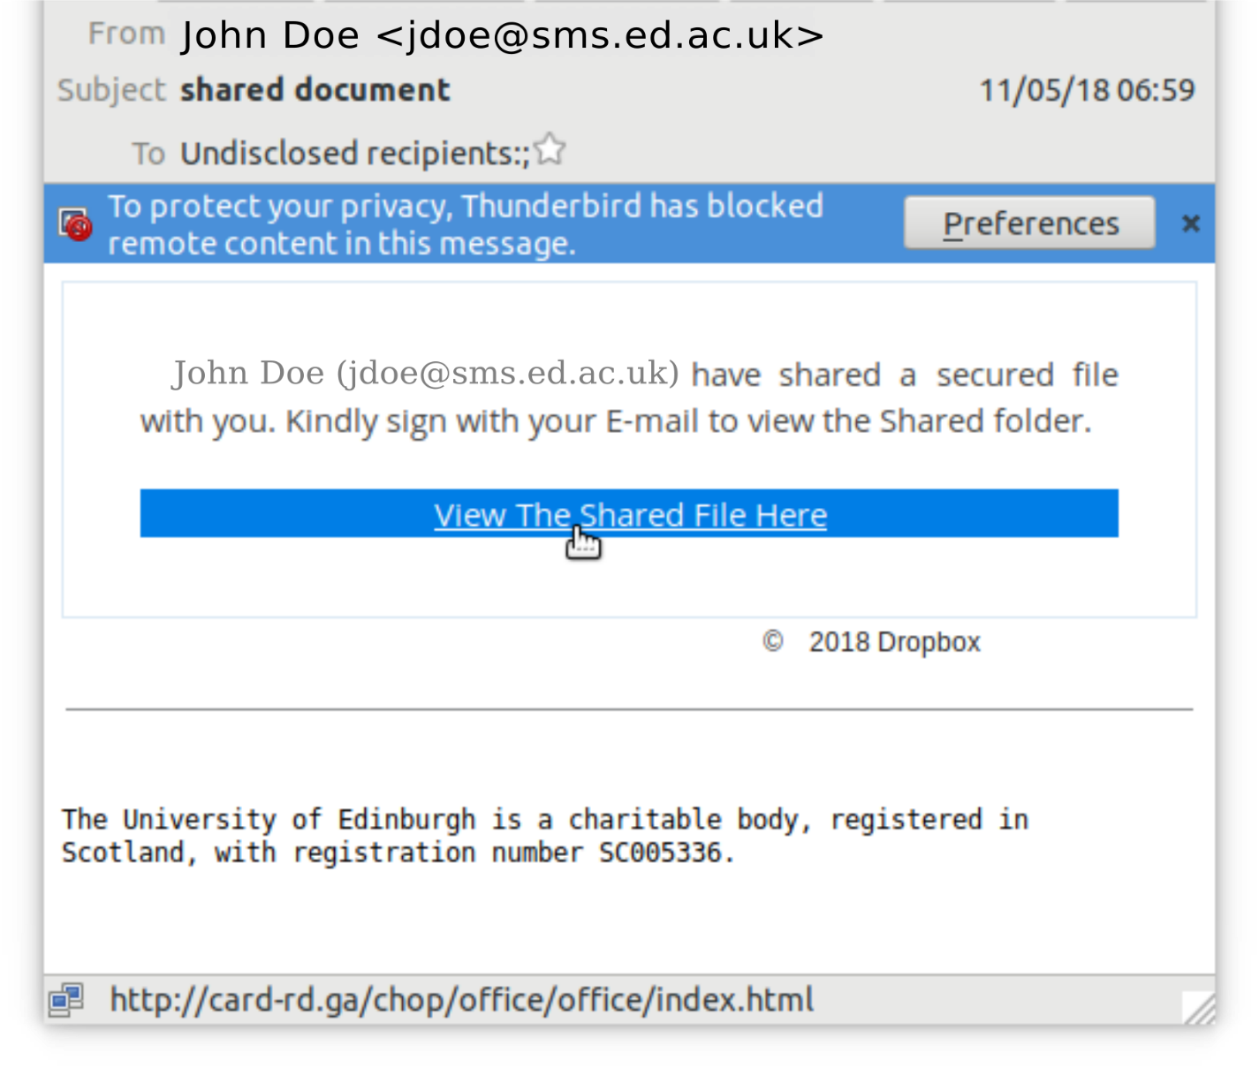
Definitely phishing
Sent to “undisclosed recipients”
Claims to be from Dropbox but sent from a student
URL goes to card-rd.ga instead of Dropbox

Slide 7
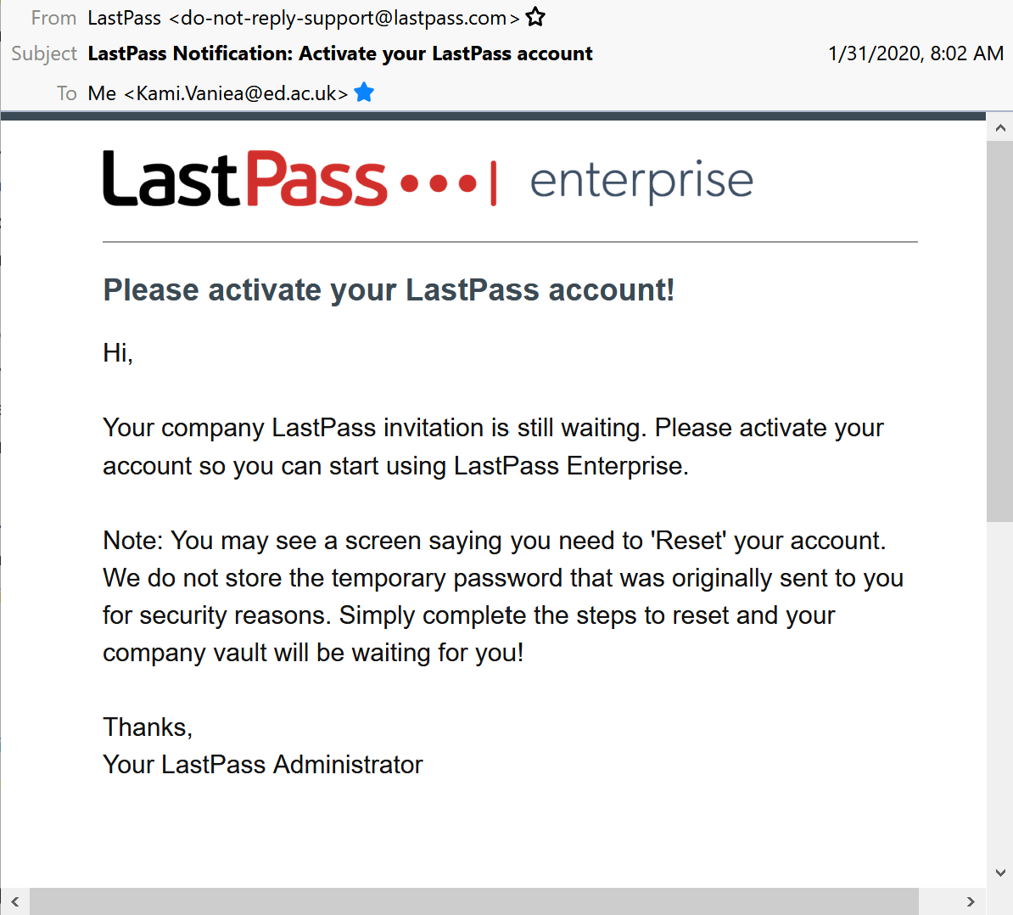
Phishing?
“Hi” without recipient name
Generic “your company”
Request to reset account
Generic “Administrator” salutation
Real email from LastPass

Slide 8
Phishing is an authentication problem

Slide 9
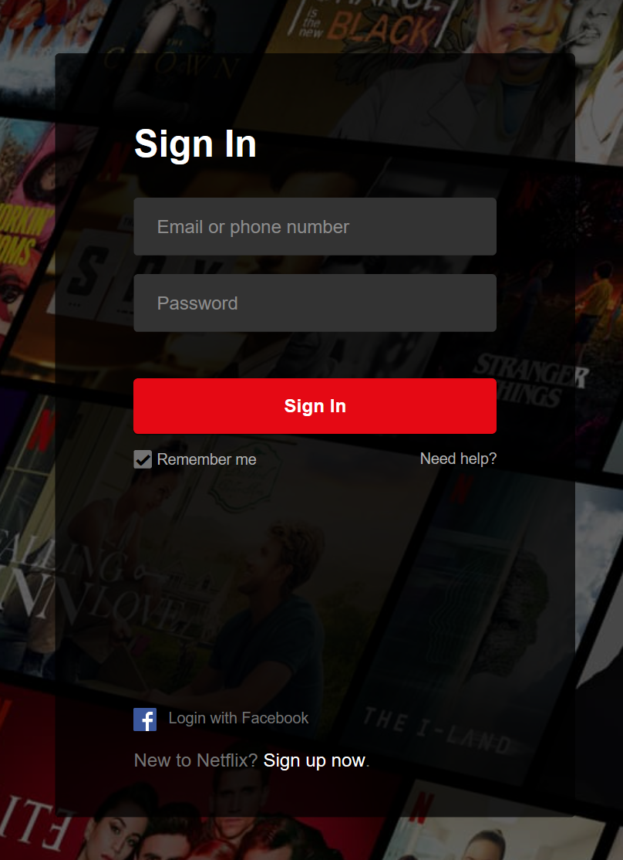
We normally think of authentication as one directional

Slide 10
But it is two directional
The user must first make sure they are interacting with the “correct” website. Then the website must make sure that they are interacting with the “correct” user.

Slide 11
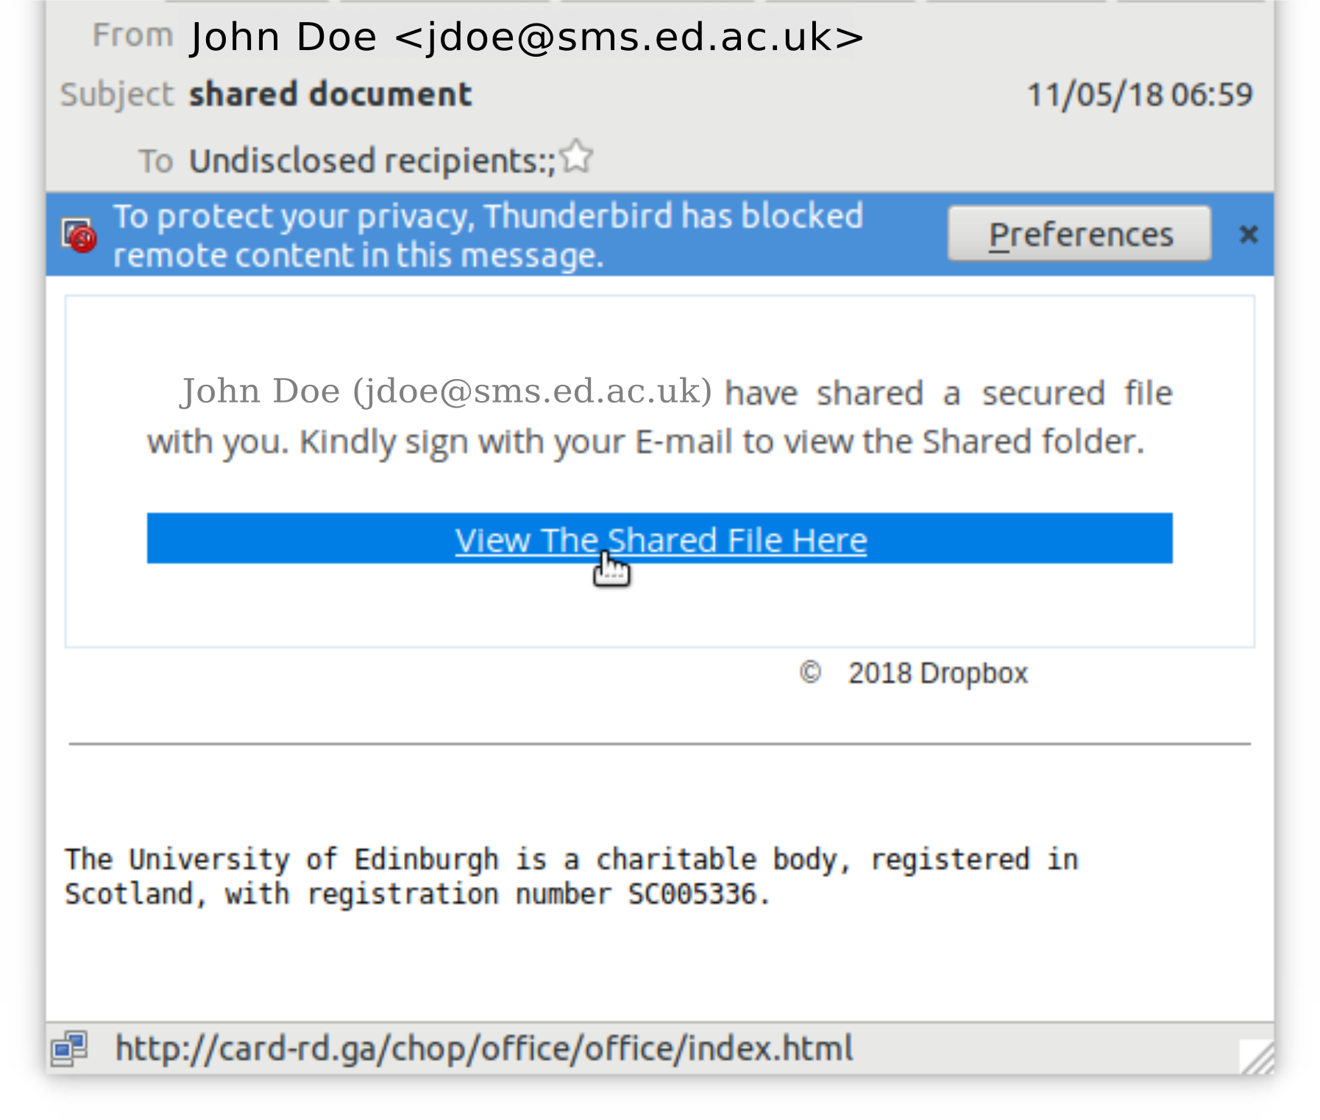
Dropbox?
Layout is hinting at being Dropbox
Copyright from Dropbox (image)
Attempt to get the user to assume Dropbox and click without checking

Slide 12
Can’t computers do the authentication for users? The AI and Cryptography stuff should be able to say if this is really from Dropbox.

Slide 13
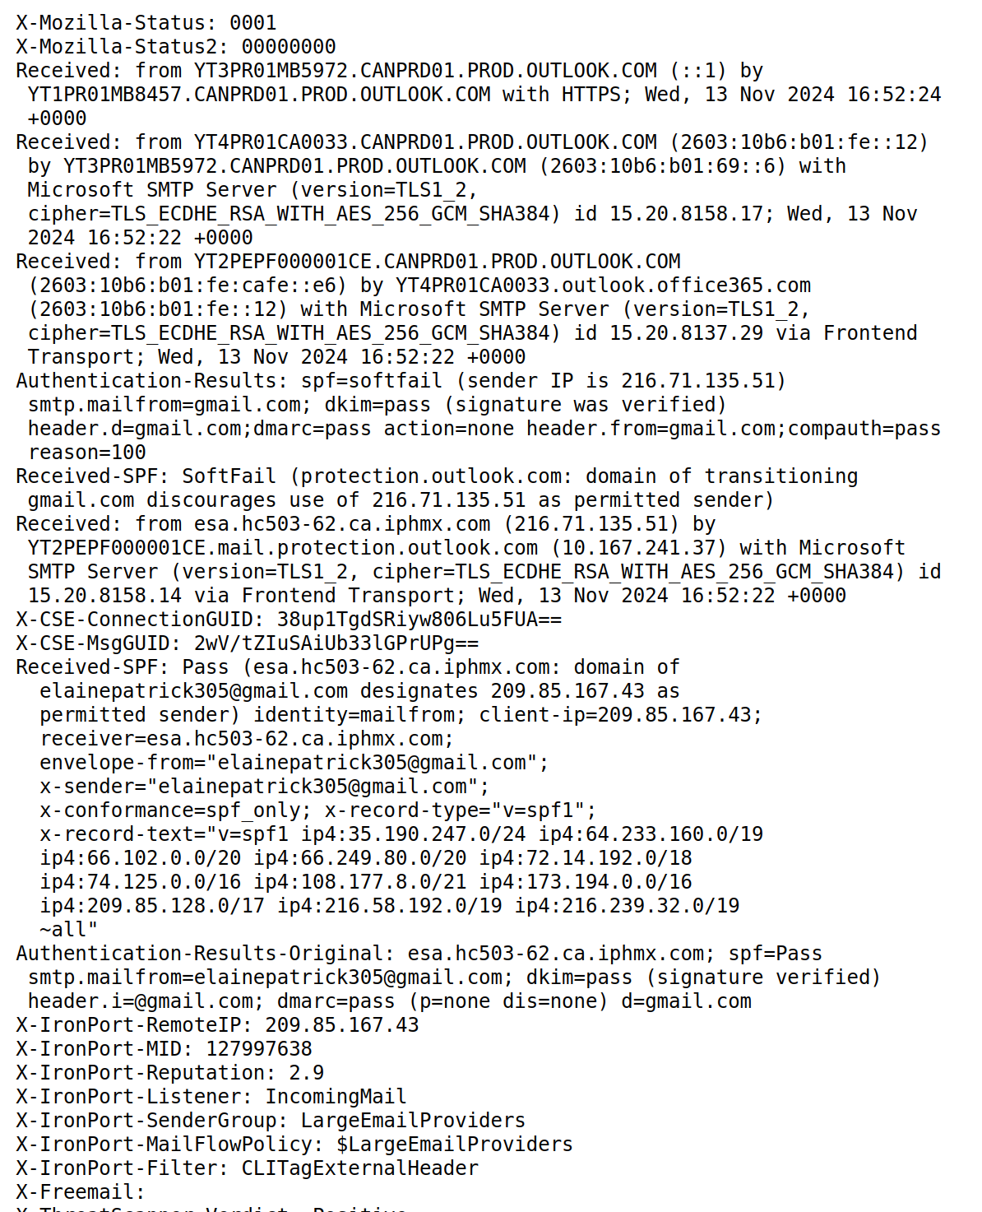
Emails come with loads of computer-readable facts
Who sent this email
DKIM/DMARC signatures
Servers the email was sent through
Content of the email itself
Keywords
Links
Text associated with common phishing targets
Topic of the email (financial, file, …)

Slide 14
Who is the email claiming to be from?
University email address
AI
Image
University is named

Slide 15
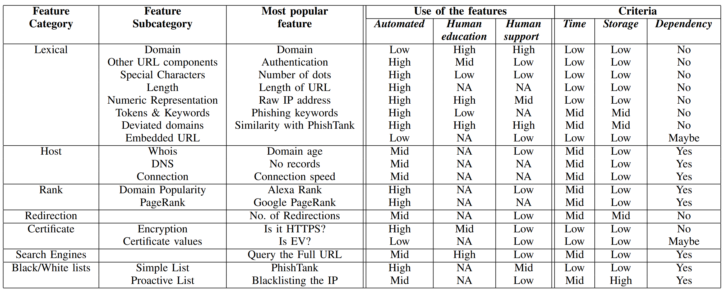
Human- and AI-facing URL features
Domain is the most used feature for humans, but is almost ignored by AI.
Why?
Humans know context, and the AI system does not.
K. Althobaiti, G. Rummani, K. Vaniea (2019). A Review of Human-and Computer-Facing URL Phishing Features. In IEEE European Symposium on Security and Privacy Workshops (EuroSPW)

Slide 16
The “Citizens Bank” problem
I bank at Citizens Bank
https://www.citizensbank.com
https://www.citizensebank.com/
https://www.citizens-bank.com
https://www.citizensbank.net
https://www.ctznsbank.com

Slide 17
The “Citizens Bank” problem
I bank at Citizens Bank
https://www.firstcitizens.com/
https://www.citizensfb.com/
https://my.thecitizens.com
https://www.gocitizensbank.com
https://www.citizensalliancebank.com/
https://www.citizensbankwi.bank
https://www.cbbank.com/
Notes:
Also: https://www.cbbank.com/

Slide 18
Users are told to determine safety: “only click on links … if you are certain … the content is safe.”

Slide 19
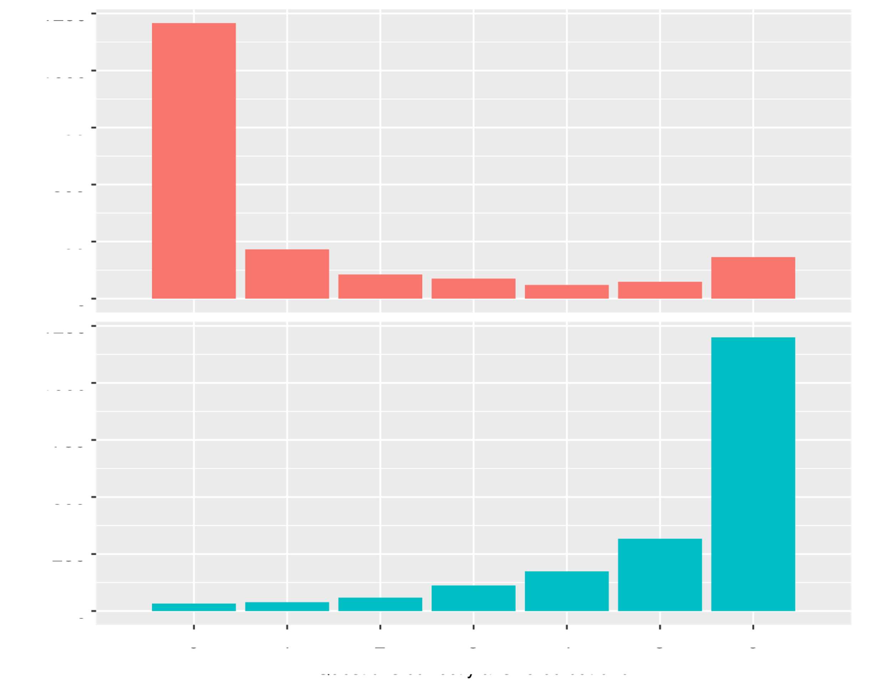
1250
Name in subdomain
Count
facebook.profile.com
paypal.mobile.com
0
1250
Name in domain
Count
profile.facebook.com
mobile.paypal.com
0
All Wrong
All Correct
S.S. Albakry, K. Vaniea, M.K. Wolters; “What is this URL's Destination? Empirical Evaluation of Users' URL Reading”; In CHI 2020.

Slide 20
What is the minimal set of facts needed to judge if a URL is going where the user expects it to go?
Users need to compare expectations against facts
Because of the “Citizens Bank” problem:
“Is this Citizens Bank?”
“Is this the Citizens Bank I am thinking about?”
Auto detect common tricks like:
Too many subdomains
Popular organization name in subdomain
Domain TLD out of position
Security words
UTF16 look-alike character swap
I bank at Citizens Bank
K. Althobaiti, N. Meng, K. Vaniea; “I Don't Need an Expert! Making URL Phishing Features Human Comprehensible”; In CHI 2021.
Notes:
The initial design went through many changes during the focus group sessions until we reached the final design on the last image.

Slide 21
Phishing is AI hostile

Slide 22
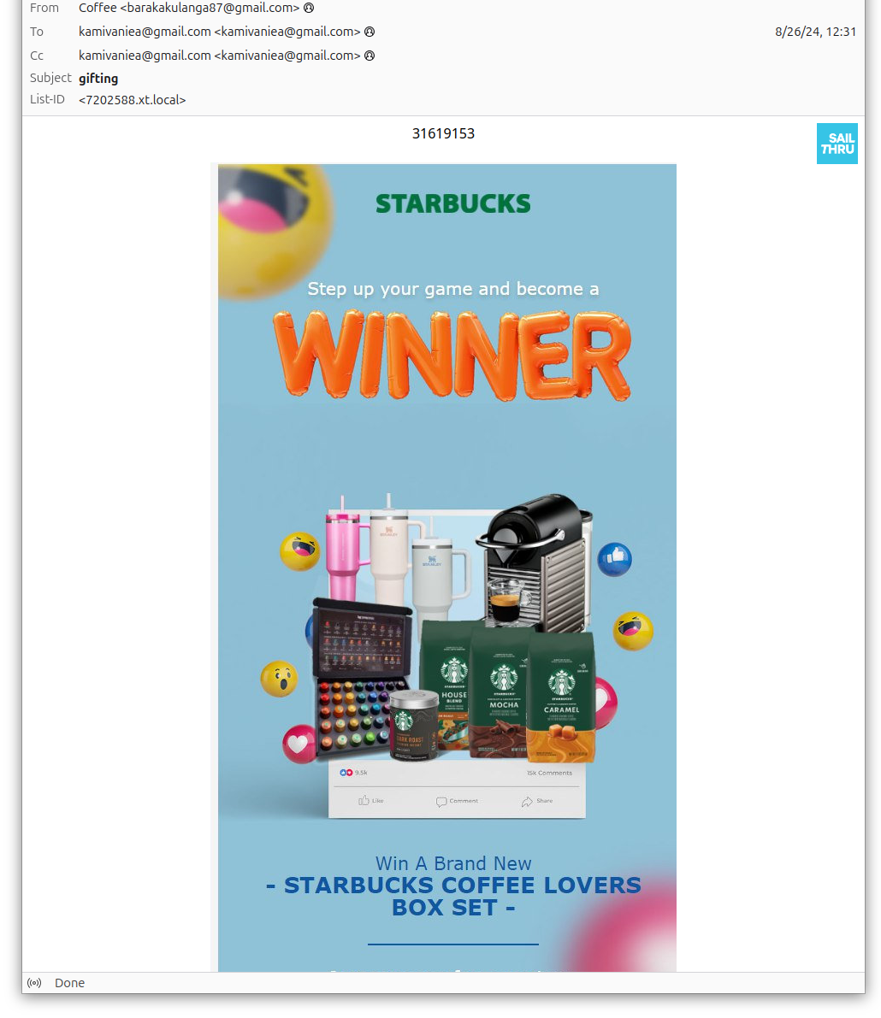
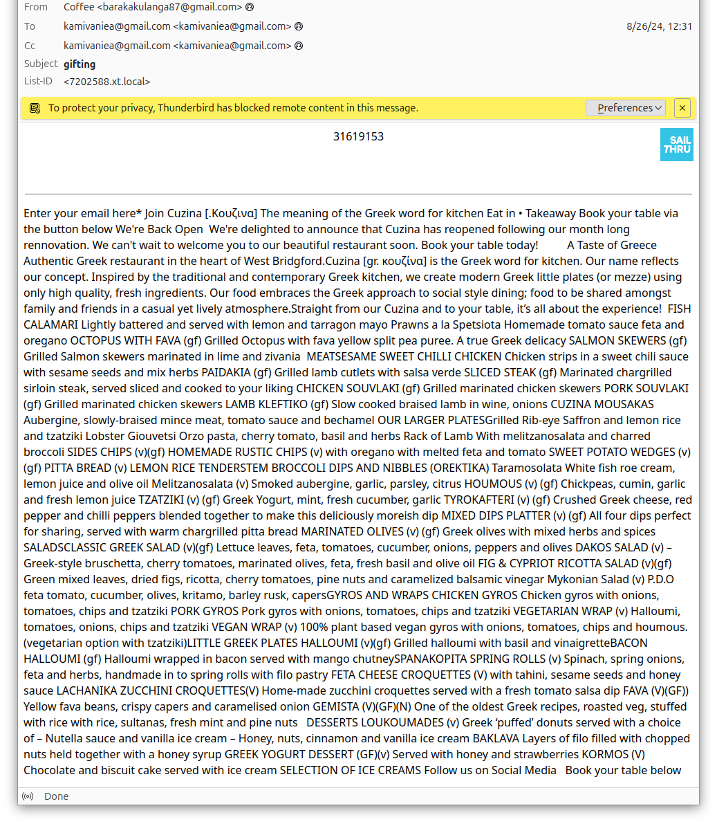
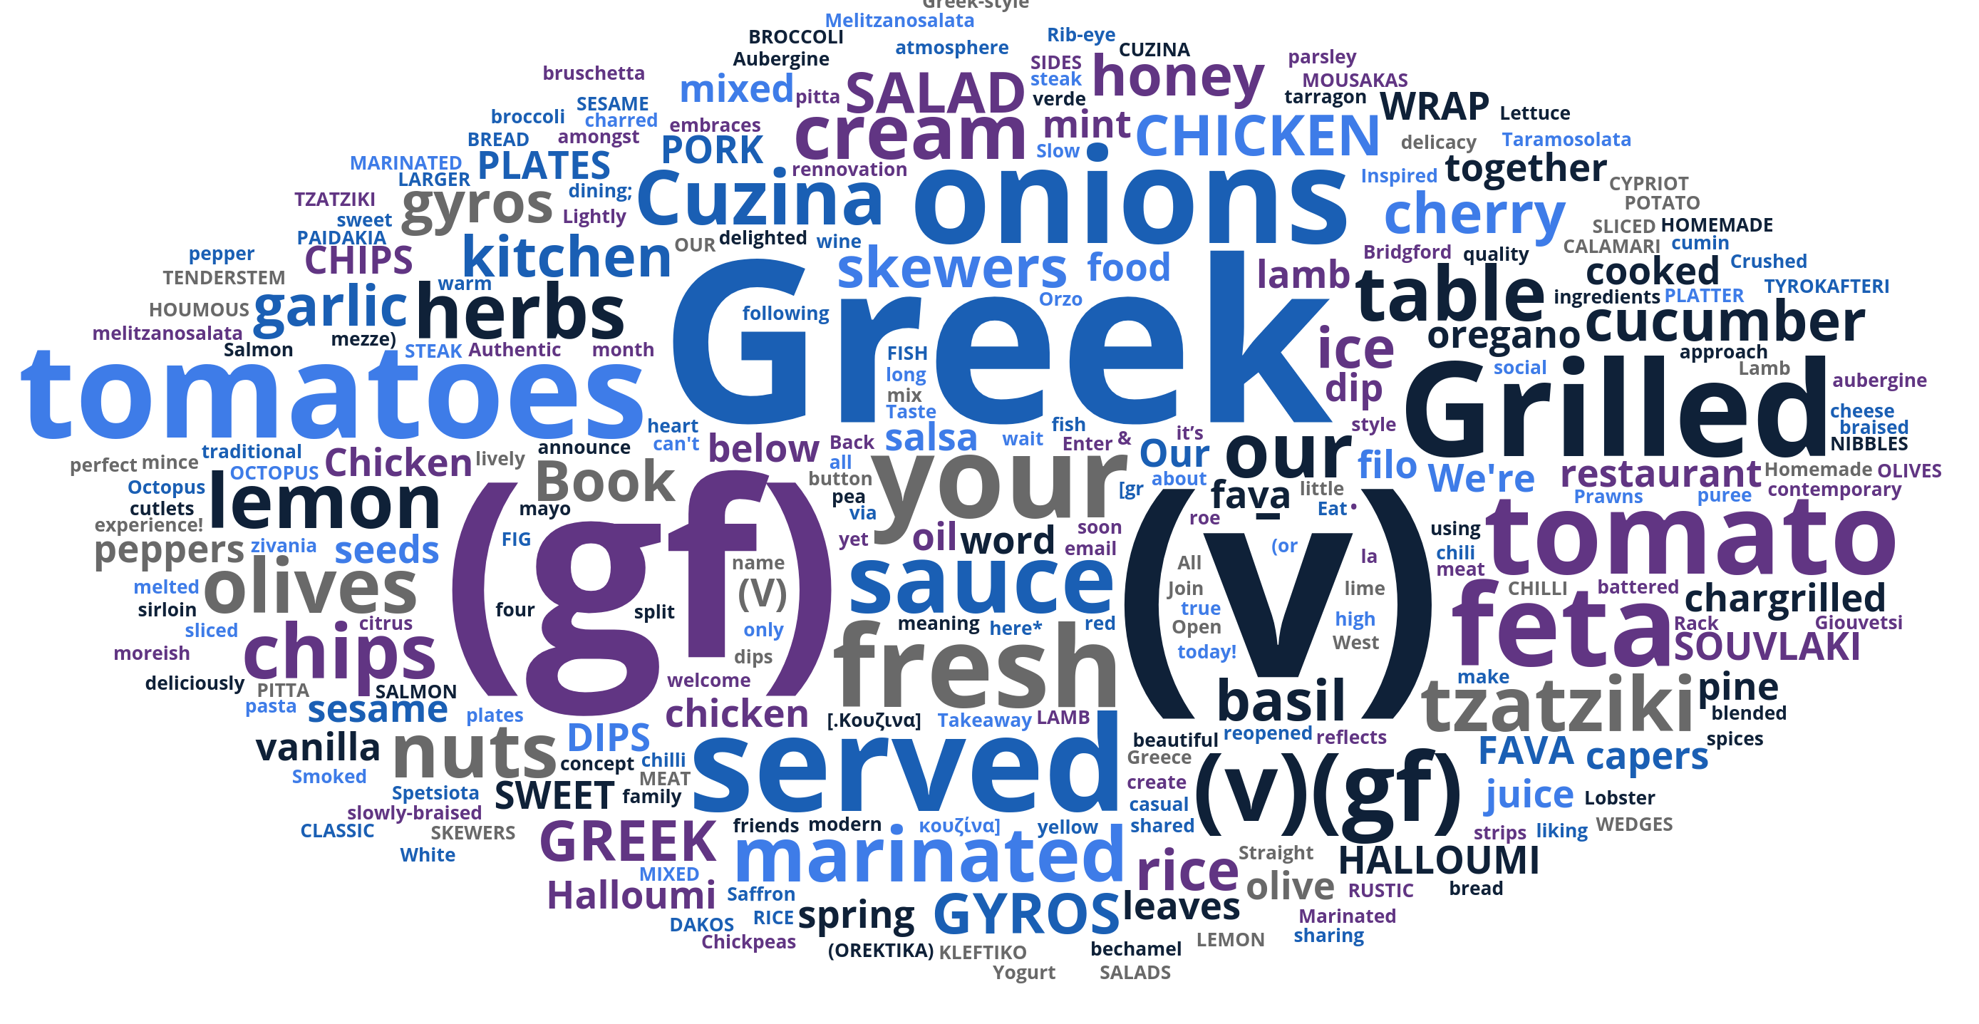
https://storage.googleapis.com/76c1577075dba36f1594/64bbeccd27bd2eeaef407ae9d...
Tarini Saka, Kami Vaniea, Nadin Kökciyan (2024). PhishCoder: Efficient Extraction of Contextual Information from Phishing Emails. In Proceedings of the Workshop on Security and Artificial Intelligence (SECAI 2024)

Slide 23
Typical AI scenario
Phishing?
Benign
AI
Phishing
https://storage.googleapis.com/76c1577075dba36f1594/64bbeccd27bd2eeaef407ae9d...

Slide 24
AI
Limited compute
Real time processing
Filters
Training
Phisher
Email Server
End User
Steal Info
Useful, helpful advice
Report
Inform
More compute
Some delay ok
Services (firewall, Exchange, etc.)
Support Teams
Help Desk
K. Althobaiti, A. Jenkins, K. Vaniea; “A Case Study of Phishing Incident Response in an Educational Organization”; CSCW 2021.

Slide 25
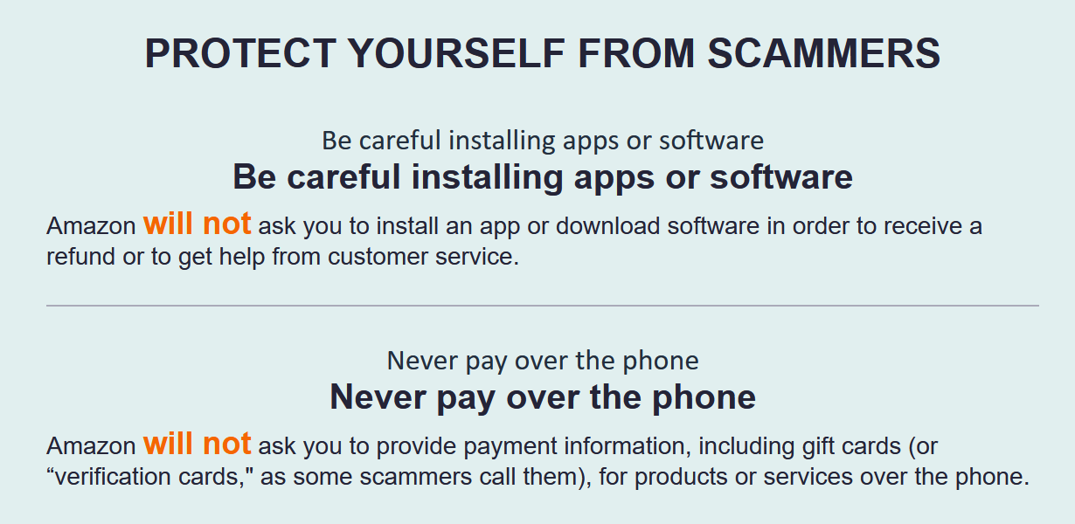
Currently give human pile of advice
Adam Jenkins, Nadin Kökciyan, Kami Vaniea (2022). PhishED: Automated contextual feedback for reporting phishing. In Proceedings of the Symposium on Usable Privacy and Security Poster Track

Slide 26
Change questions to those people can answer
AI
Package Shipper
Update information
Click link
Adam Jenkins, Nadin Kökciyan, Kami Vaniea (2022). PhishED: Automated contextual feedback for reporting phishing. In Proceedings of the Symposium on Usable Privacy and Security Poster Track

Slide 27
Change questions to those people can answer
AI
File transfer service
Files, media, or documents
Adam Jenkins, Nadin Kökciyan, Kami Vaniea (2022). PhishED: Automated contextual feedback for reporting phishing. In Proceedings of the Symposium on Usable Privacy and Security Poster Track

Slide 28
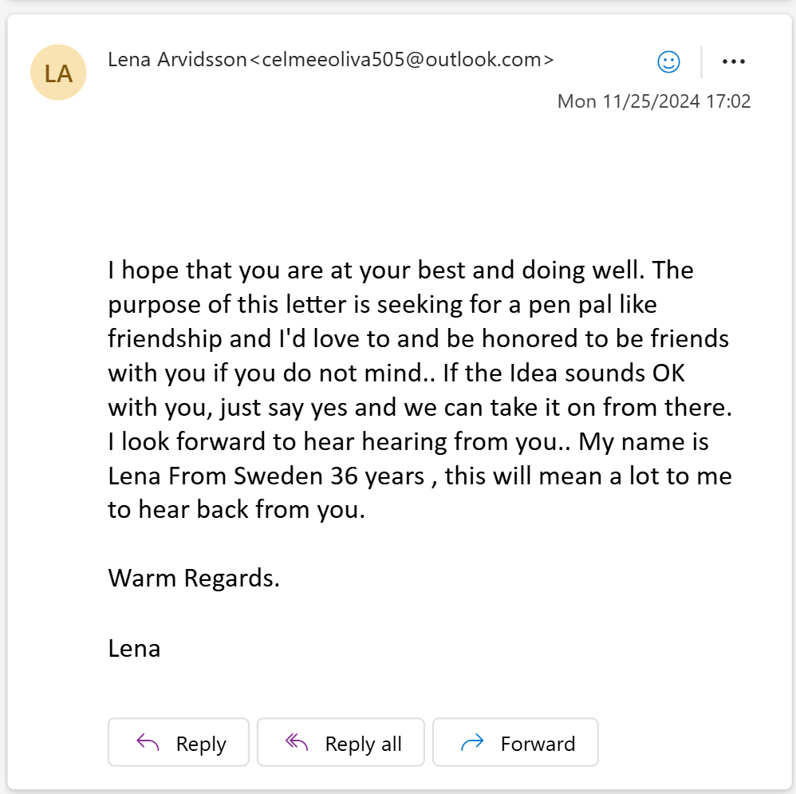
PhishEd Lessons: Humans
Providing phishing or benign classification is not enough to prevent interaction. Especially when a user does not understand the harm.
Reported phishing is an overlooked training opportunity.
Need data converted into information they can accurately judge.
Embarrassed to ask for feedback or help.
Tired of being ignored by IT support or waiting weeks for a response.
Adam Jenkins, Nadin Kökciyan, Kami Vaniea (2022). PhishED: Automated contextual feedback for reporting phishing. In Proceedings of the Symposium on Usable Privacy and Security Poster Track

Slide 29
PhishEd Lessons: AI
Explainable AI is not what we want. Users need to be able to go back and forth, not have the decision explained to them.
No accessible AI datasets represent how people perceive emails.
Phishing is AI hostile. Active attack against filtering.
“We will never” statements are not always true.
Adam Jenkins, Nadin Kökciyan, Kami Vaniea (2022). PhishED: Automated contextual feedback for reporting phishing. In Proceedings of the Symposium on Usable Privacy and Security Poster Track

Slide 30
Take Aways
Consider why humans are needed in security decisions.
Balance what computers and humans are good at.
Consider how AI and humans can collaborate to solve hard security problems efficiently.
Identity and authentication are non-trivial problems.
Dr Kami Vaniea Electrical and Computer Engineering kami.vaniea@uwaterloo.ca tulipslab.org

